Slide 1
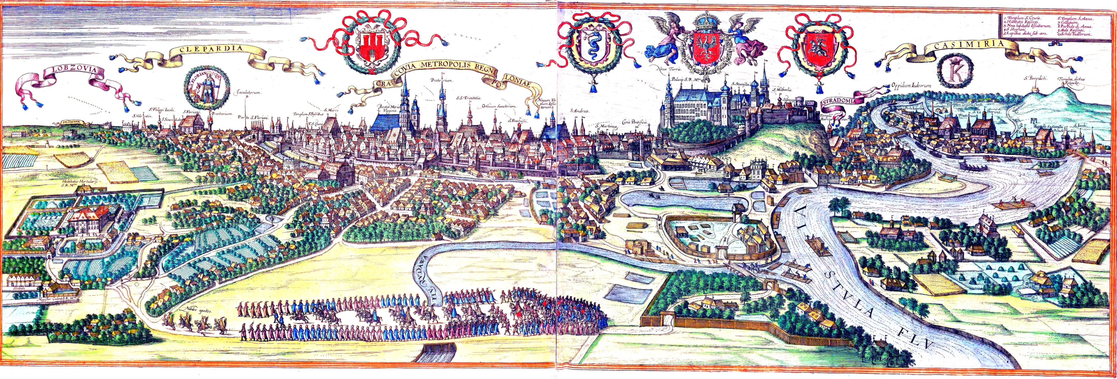
Venues of Cracow: Main square vs Kazimierz District

Slide 2
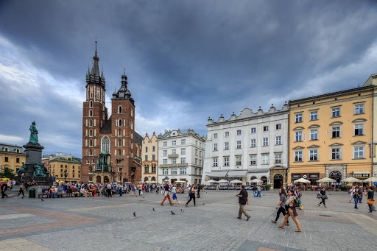
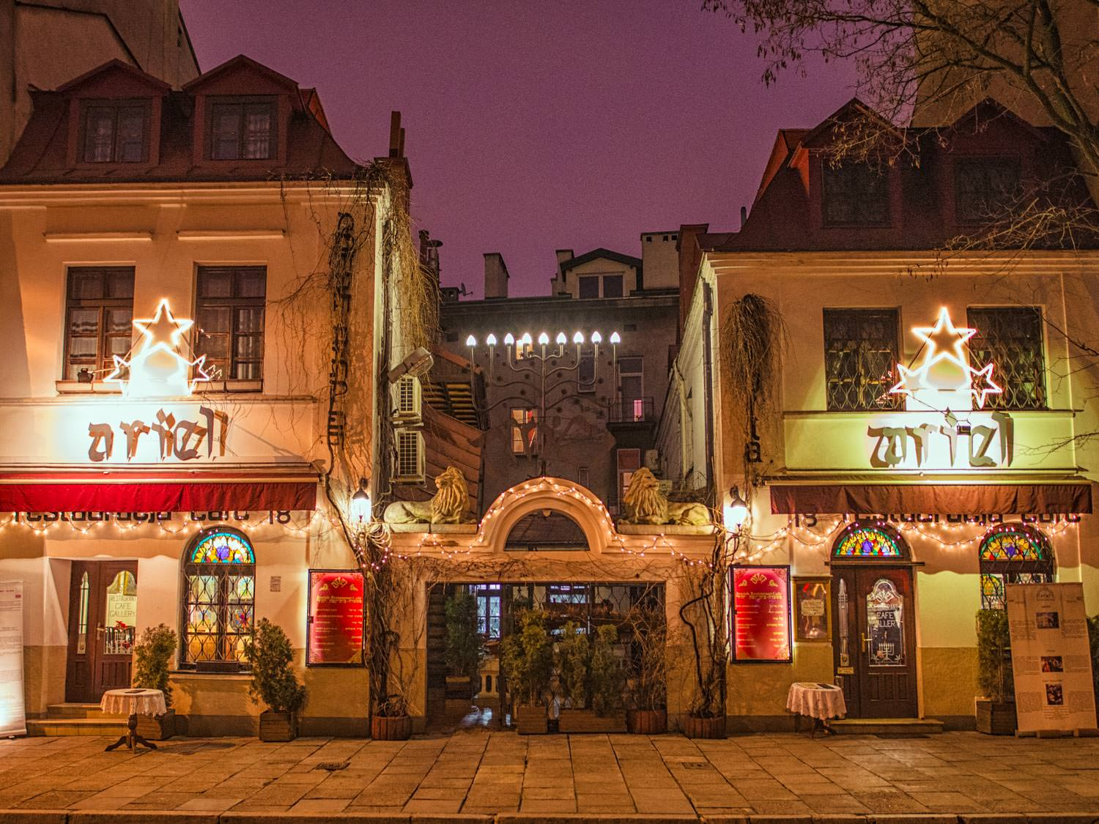
Intoduction
In this project an analysis was carried out considering two very popular neighborhoods of Cracow, which are rich in venues:
- Main Square - Kazimierz District
Conducted comparison will be aimed at finding features unique for each districts, similarities and leads for investors planning to open new venues in one of mentioned districts.

Slide 3

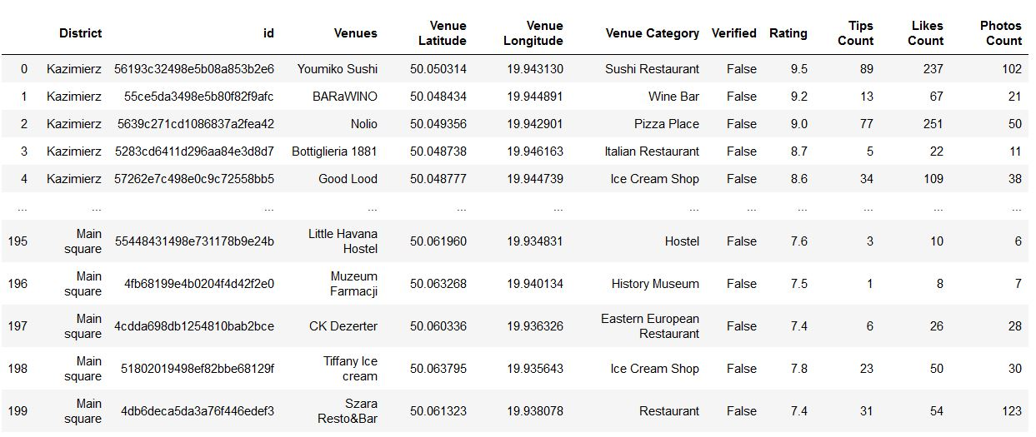
Data
The data needed for this analysis will be acquired through Foursquare developers API

Slide 4
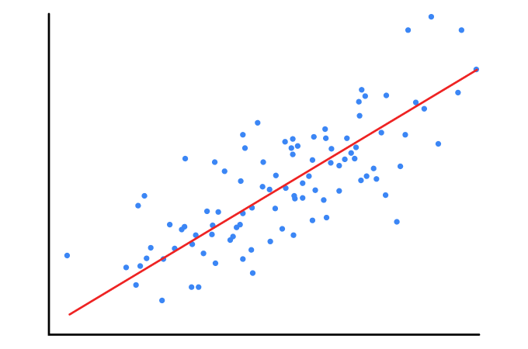
Methodology
Counting the top most popular venues in each district.
Descriptive statistics
Regression

Slide 5
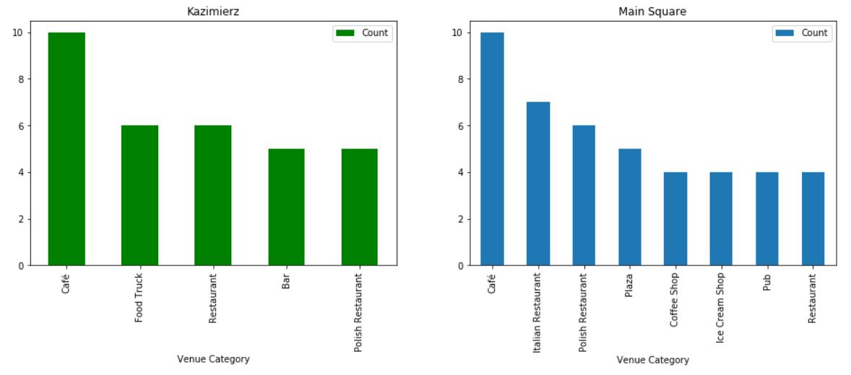
Results
Most popular categories for venues

Slide 6
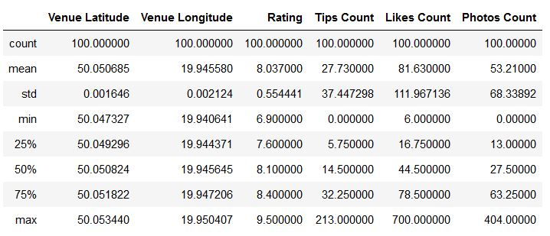
Results
Descriptive statistics for Kazimierz District

Slide 7
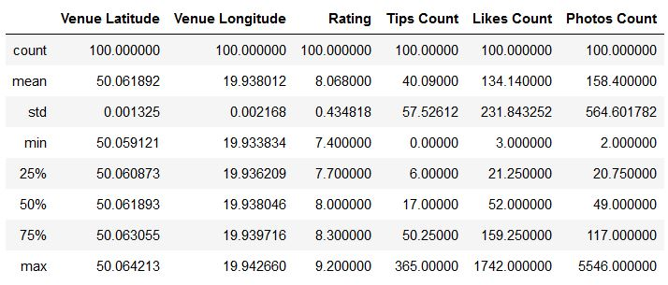
Results
Descriptive statistics for Main Square

Slide 8
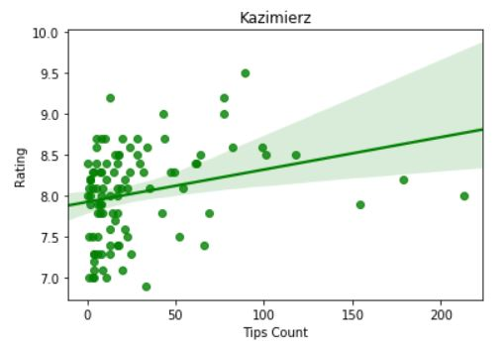
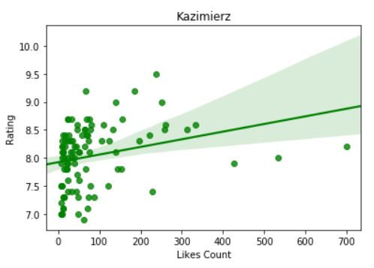
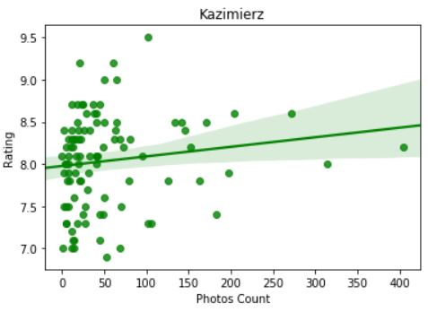
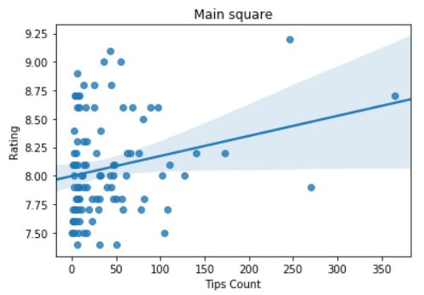
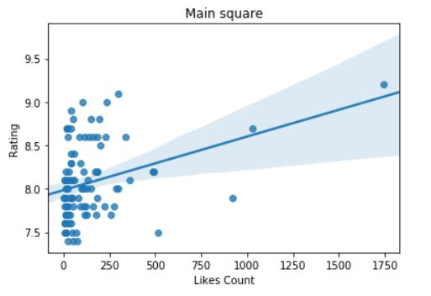
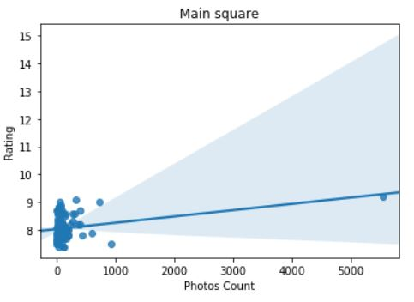
Results
R2 score = -6,8212363524512
Linear regression

Slide 9
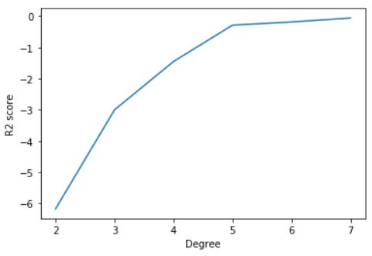
Results
Polynomial regression

Slide 10
Discussion and conclusion
The most popular category of venue for both districts is Cafe.
Next in order of popularity are: for Kazimierz District – Food Trucks and Restaurants, and for Main Square – Italian Restaurant and Polish Restaurant.
Average venue rating for both districts are similar, and is around 8,0.
In venues in Main Square visitors take make photos then in venues in Kazimierz District.
Both linear and polynomial regression showed no correlations between ratings and other details of venues.
Number of photos per venue, and popular type of venues in each district maight sugest that Main Square is more popular among tourist, while Kazimierz District is also popular among local residents

